Slide 1


Lost and Found Data Analysis - NITJ
A comprehensive analysis of lost-item reports and student survey responses at NITJ. This deck summarizes frequency, common items, departmental hotspots, recovery outcomes, monthly patterns, and actionable recommendations for a centralized lost-and-found system to improve student experience and campus accountability.
Made by Sohit Kumar & Stanzin Druksel
Submitted to Dr. Jagdeep Kaur

Slide 2

Introduction
The purpose of this analysis is to identify patterns in lost-and-found incidents using two primary sources: structured student surveys (n = 100 responses) and college lost-item logs from the past academic year.
Our goal: translate data into operational recommendations that reduce loss incidence, increase recovery rates, and evaluate the feasibility of a centralized reporting system.

Slide 3


Objectives
Primary questions we answer
Decision support
How often do students lose items and which items?
Provide data-driven recommendations for policy changes, staffing, signage, and a low-cost digital reporting tool that integrates with campus safety and student affairs workflows.
What campus areas and departments report the most incidents?
How effective are current recovery practices?
Is a centralized digital + physical system justified?

Slide 4

Why This Problem Matters
Student Well-being
Operational Inefficiency
Safety & Accountability
Frequent losses create anxiety, missed deadlines (lost IDs, notes), and administrative burden for students and staff.
Decentralized handling leads to duplicate efforts, lost records, and low visibility into recoverable items.
Untracked personal electronics and ID cards present security and privacy risks; a documented chain-of-custody is absent.

Slide 5
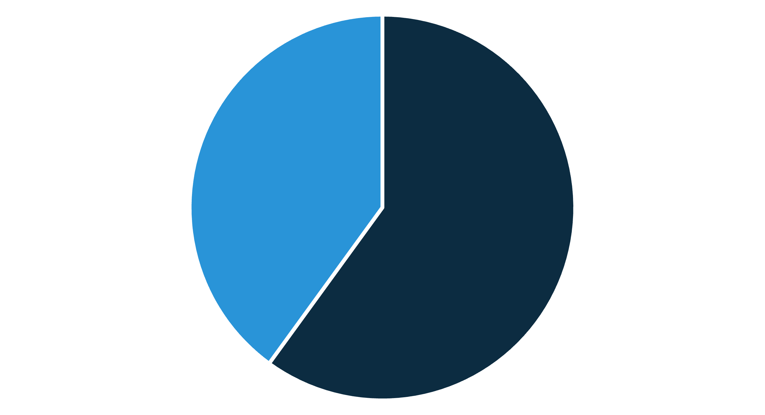
Findings — Student Loss Experience
Yes
No
Approximately 60% of surveyed students reported losing at least one item on campus during the past year. This high prevalence underscores the need for improved prevention and streamlined recovery processes.

Slide 6





Most Common Lost Items
ID Cards
Notebooks
Water Bottles
Academic impact—lost lecture notes and assignments. Often irrecoverable if not submitted digitally.
Often left in lecture halls and labs. Low monetary value but high frequency and clutter in communal spaces.
Critical: access and identity. Immediate administrative burden when lost; replacement costs and security steps required.
Laptop Bags & Electronics
Pen Drives
Higher value items that pose theft and data-security concerns; lower recovery probability without tracking.
Contain coursework and personal data. Data-sensitivity risk if recovered by unauthorized individuals.

Slide 7
Loss Incidents by Department
Engineering and computing departments report the highest number of incidents—likely related to larger class sizes, shared labs, and portable electronics usage. Targeted interventions in these areas can yield high impact.

Slide 8

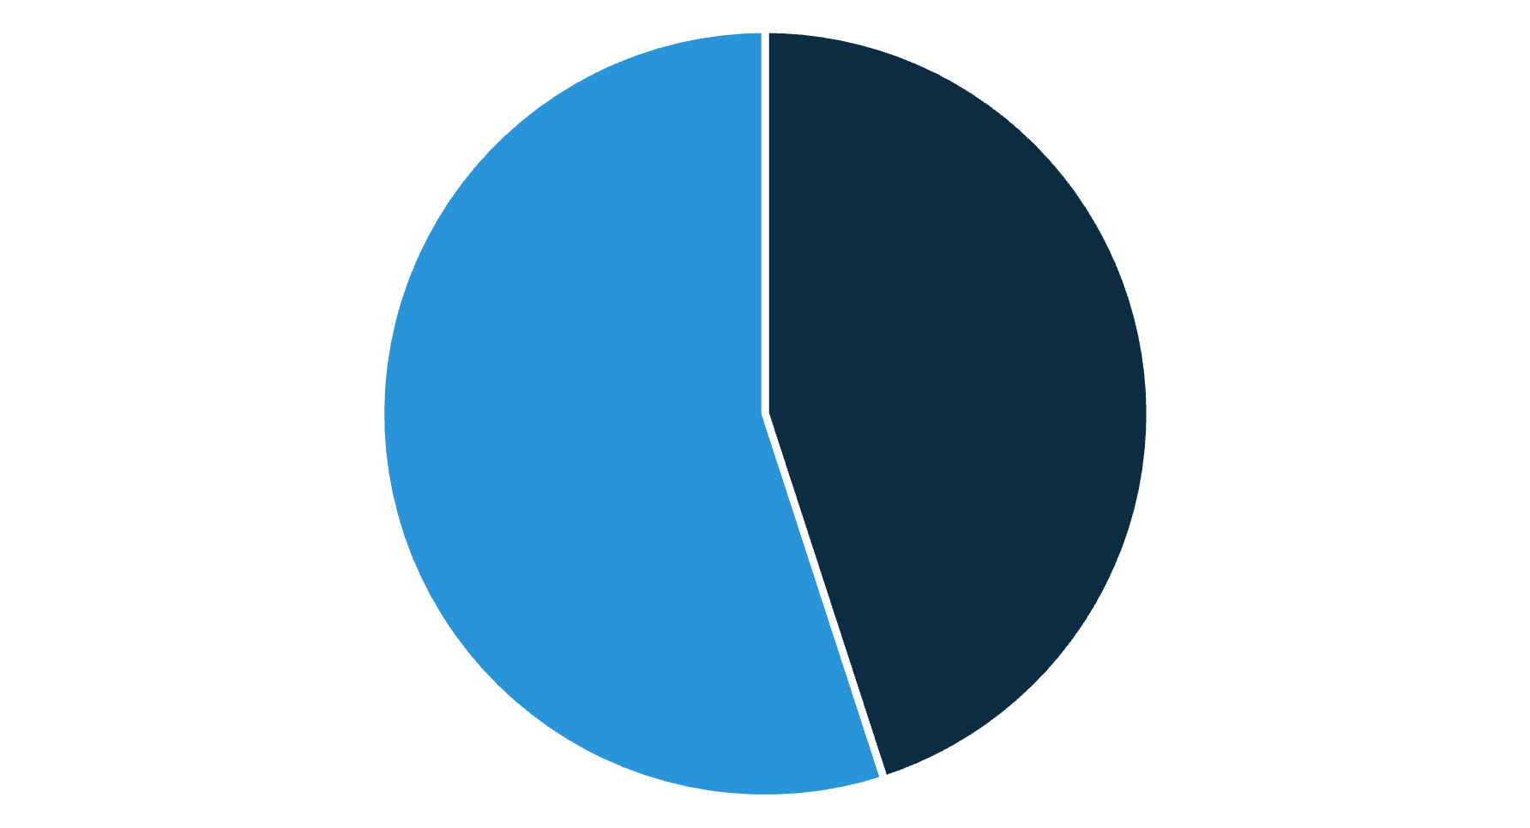
Recovery Success Rate
Only about 45% of lost items are successfully returned. Barriers include lack of a single reporting point, inconsistent logging procedures, and limited awareness of where to check. Improving intake and notification will directly increase this rate.
Recovered
Not recovered

Slide 9
Monthly Trend — Peak Months
Losses spike in September and October—coinciding with the start of the academic year, increased events, and high student movement. Proactive signage, temporary extra staffing, and orientation briefings in these months are recommended.

Slide 10
Category vs. Month — Patterns & Recommendations
Key insight
High-impact actions
Water bottles, ID cards, and electronics are lost year-round but surge at semester start. Yearly patterns suggest both behavioral and operational contributors.
Implement a single digital report form + SMS/email notifications to owners
Create physical, staffed centralized lost-and-found hub open peak hours
Improve signage, orientation messaging, and departmental drop-boxes in high-traffic areas
Security safeguards
Next steps
Standardize logging with item photos, timestamp, and steward signature to reduce disputes
and protect sensitive data.
Pilot a digital reporting form + notification for one semester (focus CSE & common areas)
Assign centralized hours and train student-staff volunteers
Measure KPI: recovery rate (+target 70% within 6 months) and time-to-return

Slide 11

The Need for a Unified Lost & Found System at NITJ
This analysis presents the case for implementing a centralized, digitally-managed Lost & Found system at NITJ. Currently, the fragmented approach to managing lost items leads to low recovery rates and significant frustration among the student body. A streamlined system promises to enhance operational efficiency, student convenience, and overall campus trust.
Overwhelming Support for Centralization
Our recent survey indicates strong endorsement from the community for modernizing this essential service. The current system, or lack thereof, is widely viewed as inefficient, leading to
unnecessary stress for students who have lost valuable items.
Strongly Support
Support
Neutral/Unsure
Do Not Support
80% of Respondents Support a Centralized System
This clear mandate confirms that the status quo is unacceptable and that the administration has a significant opportunity to address a widespread student need with a technological solution.

Slide 12
Key Features: Meeting Student Expectations for a Modern System
To ensure high adoption and effectiveness, the new Lost & Found system must incorporate features that directly address student pain points and leverage current technology. The following suggestions were prioritized by students in our focus groups and surveys, highlighting the demand for digital accessibility and transparency.
Online Reporting Portal/App
Dedicated Office or Desk
Allow students to easily log a lost or found item from anywhere via a mobile app or web interface, including uploading photos and detailed descriptions.
Establish a single, easily accessible physical location for item storage, pickup, and drop-off, staffed during peak hours for reliable service.
Volunteer Management
Portal Notifications
Implement a system for managing student volunteers to assist with daily operations, cataloging items, and facilitating efficient item transfers.
Utilize push notifications or email alerts to instantly notify a student when a match is found for their lost item, significantly speeding up the recovery process.
The integration of these features will transform the Lost & Found from a passive service into an active, transparent, and student-centric operation.

Slide 13
Conclusion: The Unmet Need for Efficiency and Trust
The analysis confirms three critical points that necessitate immediate action regarding the campus Lost & Found services. These points underscore the impact of the current inefficiency on the student experience.
High Incidence of Item Loss
Inefficient Recovery Rates
Strong Support for Digital Solution
A substantial number of students face the daily inconvenience and financial burden associated with losing valuable personal items such as IDs, electronics, and textbooks on campus.
The current low recovery rate is a clear indicator that the existing, fragmented approach is failing. Items are misplaced between departments, leading to a breakdown in process and trust.
The student community overwhelmingly advocates for a modern, digital solution that provides transparency, ease of use, and a single point of truth for all lost and found activities.
Improving this system is not just an administrative task—it is an opportunity to positively impact campus safety, reduce student stress, and demonstrate administrative responsiveness to student needs.

Slide 14





Strategic Recommendations for Implementation
To move from concept to execution, we propose a phased approach focusing on technology, personnel, and physical infrastructure. These steps will establish a robust, campus-wide system.
Develop Central Platform
Assign Dedicated Staff & Volunteers
Launch a dedicated web and mobile application for reporting lost items, cross-referencing found item logs, and facilitating secure item claims.
Designate a Student Affairs coordinator for oversight and recruit a team of reliable student volunteers for daily intake, logging, and distribution tasks.
Implement Collection Points
Ensure Regular Communication
Install standardized, clearly marked collection boxes in high-traffic areas (e.g., library, student union, main lecture halls) for easy item drop-off.
Establish automated alerts (email/SMS) to notify users of status changes, successful matches, and final claim deadlines, ensuring timely recovery.
Phasing in these recommendations over the next semester will allow time for testing, training, and integration into existing campus safety protocols.

Slide 15

Final Note: Building a Better Campus Experience
The integration of an organized, digital Lost & Found system is a small investment with a significant return. It directly addresses a source of student anxiety and contributes to a perception of an organized, caring administration.
Enhanced Student Convenience
Increased Campus Trust
Students can quickly report and track items without navigating multiple offices, saving valuable time and reducing stress during the academic year.
High recovery rates and process transparency will improve student confidence in campus services and foster a culture of accountability and helpfulness.
Operational Accountability
Centralized logging and management provide administrators with clear metrics on lost items, trends, and recovery performance, enabling continuous improvement.
An organized Lost & Found system will improve student convenience, trust, and accountability at NITJ.
We look forward to partnering with NITJ administration to make this vital upgrade a reality.

